Slide 1
Fed or No fed?
Resume writing for the prospective government Employee

Slide 2
True or false
A federal resume should not exceed two pages in length

Slide 3
FALSE
A federal resume requires more information than a civilian resume, therefore, it is typically longer than two pages. Some of the things that should be included are your educational and work experience. This includes job titles, salary, employment dates, duties and accomplishments, and how it relates to the knowledge, skills and abilities (KSAs) in the job announcement.

Slide 4
True or false
Resumes are scanned for keywords by an automated system

Slide 5
Somewhat true
Real people, Human Resource (HR) specialists, do look at resumes, however some agencies also use an automated system to review resumes. For the agencies that do use an automated system, the resume review process has two parts:
■An automated application review process to include all the required areas of the applicant’s eligibility and qualifications for the job.
■A manual review, by the HR Specialist, of an applicant’s resume to validate the information in the application package.

Slide 6
A tale of two resumes
Federal
■USAjobs.gov
■Length –HR uses resume
■Detail –small paragraphs/multiple bullets
■Accomplishments –necessary to be the best qualified and referred
Private Sector
■LinkedIn, Monster, Facebook, etc
■1-2 pages, doesn’t need all the details
■Bullet statements
■Not usually included

Slide 7
You do it: Draft a Description
Draw a line down the center of a piece of paper
Use your current internship and jot down how you would write it on a non-federal resume, leaving a few lines between each point
Then, in the other column, expand how you would describe the same job but for a federal resume

Slide 8
Example
Non Federal
Federal
Staff visitor center desk
Routinely scheduled to operate main park visitor center, receiving up to 2000 visitors per day. Responsible for opening/closing facility, operation of complex audiovisual system in theater . . .

Slide 9
Duties vs. responsibilities
Everyone is the same
Unique to you
A duty is a work task that everyone in the same type of position routinely performs, such as all park guides prepare and present 15 minute orientation talks
You are the person in the work group responsible for ensuring that daily statistics are entered into spreadsheet and compile monthly statistical reports and submit to your supervisor

Slide 10
accomplishments
Beyond Duties (Tasks everyone who is “similarly situated” perform) and Responsibilities, describe your Accomplishments.
Example: Piloted new interpretive program for high school audience on life of Carter Woodson tied to Georgia State Social Studies standards. The program has been added to the park’s regular “menu”of programs available for school groups.

Slide 11
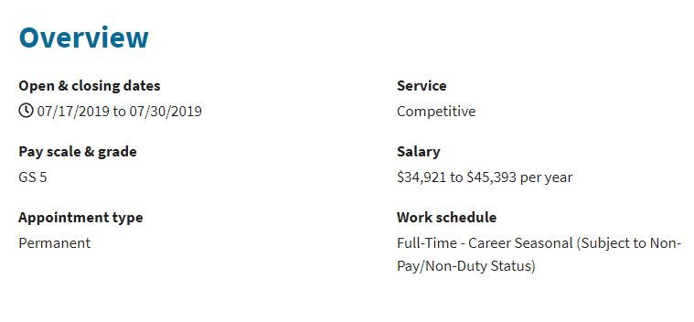
Back to usajobs

Slide 12
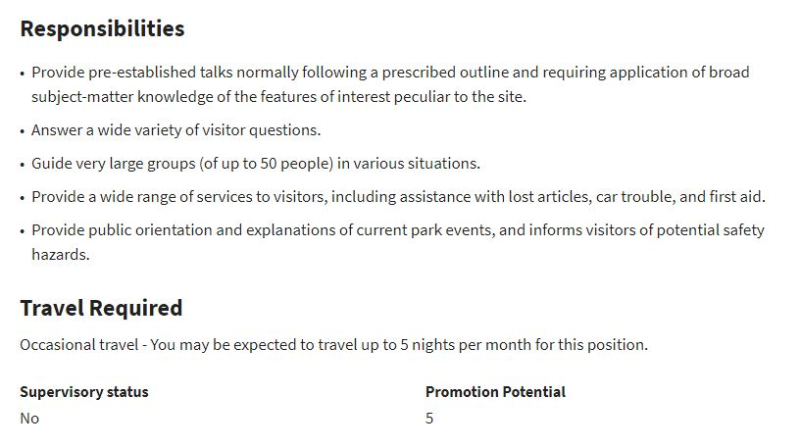
Read the responsibilities

Slide 13
Hiring process
YOUR RESUME is your application
Qualifications (Job Announcement)
Education
Training
Level of Experience
Amount of Experience

Slide 14
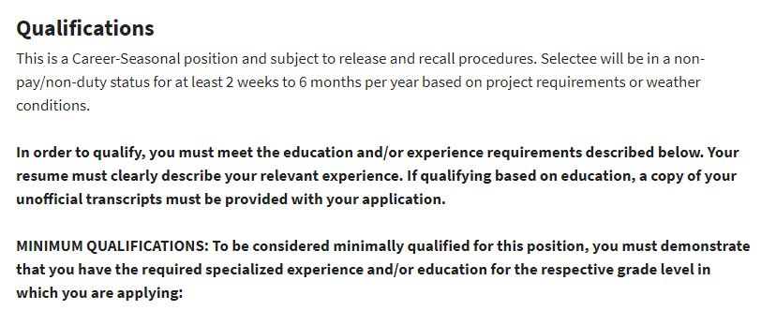
Is it a match?

Slide 15
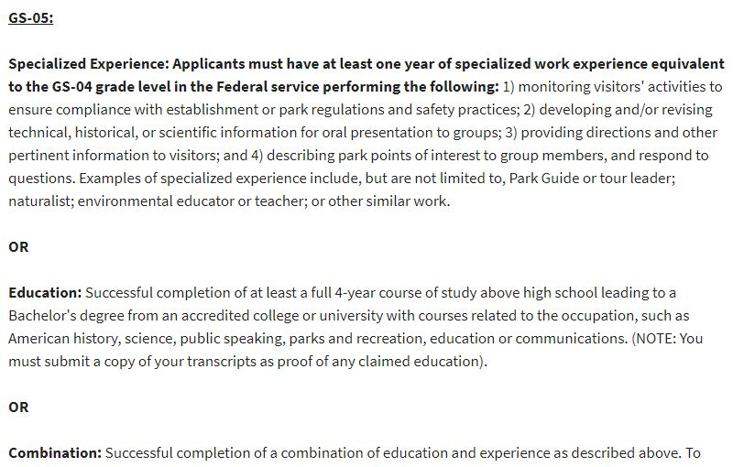
Is it a match?

Slide 16
You in a nutshell
Your resume is your best marketing tool
Communicates your qualifications
Shows you can provide immediate results
Should be tailored for each job
Has no page limitations
Is your first and often only impression
Reverse Chronological Order

Slide 17
Not just one
USAJobs allows you to upload and maintain up to five different resumes tailored to different types of jobs

Slide 18
ksas
Knowledge
Skills and
Abilities

Slide 19
Always include
Hours
Highlight your experience –which provides an overview of your abilities
What work did you do and how long did you do it?
Level of experience – examples
Were you a project manager or team member?

Slide 20
Action verbs
Important but choose the “right” verb

Slide 21
Cover letter
A good idea
Give the reader a “slice”of the real you

Slide 22
Action verb vs experience
Picked up trash
Worked in collaboration with waste management staff and followed OSHA protocols to improve the beach use area for park visitors safety and recreational experience.

Slide 23
And another
Built a fence
In compliance with NEPA and Section 106 of NHPA, served as a team member to construct a twenty square foot barrier to protect a native plant restoration project.

