Slide 1
Public Land Corps
Hiring Authority and Eligibility

Slide 2
What’s Covered
Details, Requirements, and Limitations of the Public Land Corps Hiring Authority
How to Search in USAJobs for Positions Open to PLC Eligibles
General “What to Expect” When Applying
Other Potential Hiring Authorities

Slide 3
What’s Not Covered
How to Write a Federal Resume
Request a second set of slides and toolkit from Marianne for Federal Resume Writing

Slide 4
What Is It?

Slide 5
PLC IS A BUNCH OF THINGS!
The PLC is An ACT – initially passed in 1993 and amended several times – mostly recently in 2019.
The PLC is an NPS funding source that is part of the Recreation Fee 20% chunk of money. All parks can submit requests for PLC funds but the projects must employ youths who work through a conservation corps. Projects may not exceed $75,000.
The PLC is a hiring authority available to the NPS, USFWS, BOR, USFS, and a couple of other agencies.

Slide 6
Intent
To expand youth service opportunities that also benefit the public through conservation efforts that meet societal objectives

Slide 7
It Does Expire
Your certificate expires and your eligibility ends two years from the date on your certificate

Slide 8
I’ve Done a New Project
Can I get a new certificate?
Yes but
Keep track of your hours per usual
Continue to use your current certificate until it expires
Submit a new request for a certificate if you are still under the age of 31

Slide 9
Can I Use It More Than Once?
YES
You can use your PLC certificate as many times as you like until it expires – even if you are hired for a job.

Slide 10
I Lost My Certificate
You may be out of luck. Marianne is not required to maintain copies of certificates, although she may still have a copy of yours. However, she may:
Move
Resign
Retire
Otherwise not be available
You are responsible for keeping track
of your certificate

Slide 11
Using Your Certificate

Slide 12
Basic Facts
You must meet the minimum qualifications for the job(s) to which you apply
Aim for entry level work at the GS-4, 5, or 7 or WG-2, 3, or 4 (Park Guide, Visitor Use Assistant, BioTechnician, Laborer)
When “shopping” in USAJobs, you should be focusing on jobs that are open Competitive Service with the Special Authorities applicable.

Slide 13
Open to General Public
Yes, you may certainly apply for this positions
Any U.S. citizen can apply for these positions.
But your PLC eligibility won’t help you or have any impact.
All applicants are reviewed against a standard and assigned a numeric score.
The selecting official can only consider applicants in the order they appear on the list and can only consider the top three applicants at a time.
Individuals with “preference” must be offered the job before “non-preference” applicants
These positions are frequently filled within the top 3 to 5 names, even though there may have been over 100 applicants

Slide 14
USAJobs
Always in Flux

Slide 15
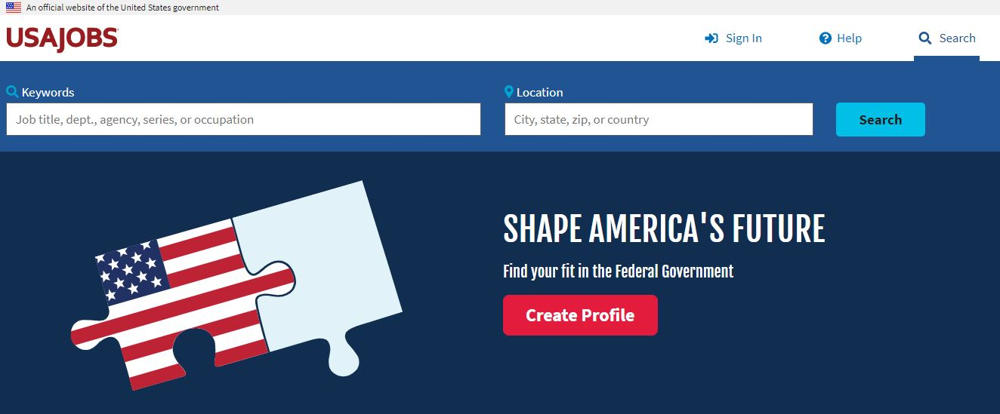
The Federal Government Platform
You must now create an account via Login.gov
USAJobs can be a bit of a . . . .
You must be verified every time you login so either have your phone available or be able to receive email messages wherever you are trying to access it.

Slide 16
In Search You Want
The advantage you have with the PLC eligibility is – you can apply for positions as if you were already “in” the system as a government employee. You do NOT have to go through the Open to the Public announcements.
However, you may certainly still apply to Open to the Public positions and I encourage you to do this. Your PLC eligibility will not “apply” however for these types of announcements.
Land and base management is still confusing in regards to the PLC.
These are merit promotion

Slide 17
In Search You Want
And you want to select Special Authorities.
The Public Land Corps is a Special Hiring Authority.

Slide 18
Other Search Points
Remember that the PLC only applies to positions with the NPS, UWFWS, BOR, BLM, USFS, USGS, and a few other agencies so also select only those land management agencies. Your PLC eligibility will not be considered for other agencies.
So – filter only for DOI or USDA land management agencies.

Slide 19
Other Search Points
In general, with a bachelor’s degree or less and less than three years of qualifying experience, I would limit my search to positions at the GS-4 through GS-7 level. Include GS-9 level if you have multiple internships.
So – filter not by salary but by grade level and select grades you are willing to accept but not likely ABOVE a GS-9 level if you have a lot of experience and a graduate degree or not ABOVE the GS-7 level with less experience and a bachelor’s, associate, or no college degree.

Slide 20
More on Merit Promotion
You will be applying for positions that are considered “Merit Promotion” – you are selected/promoted based on the merits of your application and prior government service. Although you currently may not have any government service (You have not been on the government payroll), your PLC eligibility appreciates the time you have given to public service through your internship and grants you the ability to apply – for up to two years – as if you had already “earned” merit promotion status.
The PLC is considered a “non-competitive” hiring authority; however, you must still apply for the positions via USAJobs. You cannot just be “directly hired” – which is how some supervisors understand it. HR considers it “non-competitive” because you do not have to apply through those “Open to the Public” announcements.” However, in USAJobs, you will be looking for positions considered “competitive service.”

Slide 21
More on Merit Promotion
When applying for a merit promotion announcement, all you need to do is be found qualified for the position to receive consideration for the job. All individuals referred are considered “equal.”
Announcements that are Open to the Public – Applicants are rated and ranked numerically from 70 to 100 and applicants can only be considered based on their score. Additionally, there are special categories of applicants that are given preference and are put at the top of the list regardless of their general qualifications and must be hired before anyone lower on the list.

Slide 22
National Park Service
This shows the “Special Authorities”icon; however, it is likely not open to PLC eligibles but other special authorities instead. It is a GS-14 Chief LE Ranger position and not likely to be filled by a recent intern.

Slide 23
Permanent vs. Career Seasonal
This position has promotion potential. They could offer you the position at either a GS-6 or GS-7 level (That is their decision, not your choice.) But you will eventually promote to the GS-7 level if your performance on the job merits.
Career Seasonal, Full Time: You are a permanent employee but you are laid off for a portion of each year without pay. When you are on duty, you are scheduled to work 40 hours per week.
Permanent, Full Time: You are a permanent employee who works year round, 40 hours per week.
These jobs accrue sick leave, annual leave, health insurance, and retirement.

Slide 24
Permanent vs. Career Seasonal
Career Seasonal, Full Time: You are a permanent employee but you are laid off for a portion of each year without pay. When you are on duty, you are scheduled to work 40 hours per week.
Permanent, Full Time: You are a permanent employee who works year round, 40 hours per week.
These jobs accrue sick leave, annual leave, health insurance, and retirement.
This is a maintenance position. WG (Wage Grade) and WS (Wage Supervisor) salaries are based on the local average wage for similar types of work so WG/WS salaries will vary greatly across the country.

Slide 25
Permanent vs. Career Seasonal
Full time means that you should expect to work 40 hours per week when you are working.
Career Seasonal, Full Time: You are a permanent employee but you are laid off for a portion of each year without pay. When you are on duty, you are scheduled to work 40 hours per week.
Permanent, Full Time: You are a permanent employee who works year round, 40 hours per week.
These jobs accrue sick leave, annual leave, health insurance, and retirement.

Slide 26
Permanent vs. Temporary
This is an announcement open to the General Public for multiple, temporary GS-4 Park Guides
Temporary appointments are what most NPS employees will still call “seasonals.” Temporary appointments like this can last no more than 1039 hours (maximum of six months if full time). Earn sick leave and annual leave. Minimal health insurance option. No retirement.
You may apply but your PLC eligibility doesn’t help.
As previously noted, currently the seasonal hiring process does not allow for the PLC eligibility to be applied.

Slide 27
Sorry!
This is a park ranger position but with the U.S. Army Corps of Engineers. USACE is part of the Department of Defense and is not covered by the PLC Eligibility.
No Special Authorities Icon

Slide 28
Pathways
This announcement is what’s called a “Pathways” position, which is the official federal government internship program. To apply for Pathways positions, you must be currently enrolled in an academic institution, working toward a degree or professional certificate.
Preference applies to these positions. Your PLC eligibility does not apply.

Slide 29
Clarification From the Agency
This Is It!
Ideally, it will list all of the Special Authorities that apply to the announcement, like this one does.
HOWEVER, they frequently just list one or two and then say and other non-competitive special authorities, which HR feels the applicant will understand that includes the PLC.
In other words, the PLC may apply even if not specifically listed.

Slide 30
Apply Anyway
When in Doubt
The worst thing that can happen is – you are notified that you are not eligible to apply.

Slide 31
Other Key Information in a Vacancy Announcement
Read everything including the fine print

Slide 32
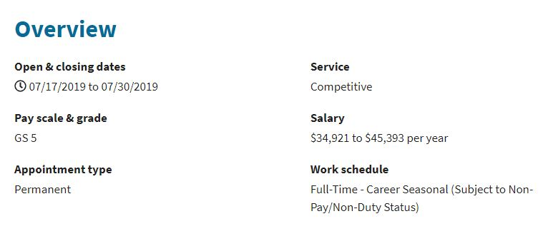
When You Can Apply
It increasingly common for announcements to state a closing date and/or a statement such as Or until 100 applications are received. This indicates they anticipate heavy interest in the position and are trying to reduce their workload so all applications received by the system AFTER 100 are in – regardless how many are actually found QUALIFIED – will be rejected.
The morale to this story is to be vigilant and check announcements in USAJobs frequently. Some announcements receive 100 applications within a few hours of posting.
You must apply by midnight “local time” so – midnight of the time zone you are in when applying.

Slide 33
usajobs
This is the lowest salary for a GS-5 and the highest salary for a GS-5. This is typically not negotiable. You will typically start at the lowest salary. This will change once you get your first permanent position but – your first permanent position, you will likely start at the lowest salary in the range.

Slide 34
usajobs
This position works 40 hours per week when in season. This position is also “laid off” for a portion of the year without salary. Look into the vacancy announcement for more details on the length of the non-duty/non-pay period. They MUST lay you off for at least one pay period (2 weeks) per year.

Slide 35
Steps to Application
Select a position
Click on the APPLY button
You’ll be asked to attach a resume. You can have multiple tailored resumes for different types of positions.
Select the resume you want to use and attach. Accept and continue.
You must upload/attach both your PLC verification of hours AND your PLC certificate of eligibility. If you do not include both, you will not be found qualified.
Include any other attachments as needed (transcripts, etc).
You will eventually be taken to the NPS section to complete a questionnaire.

Slide 36
Questionnaire
This is where you will be asked to answer specific questions about your skills and qualifications for the position and typically rate yourself from expert to no knowledge or skill.
Do not inflate yourself but also do not under-rate yourself.
Your score will be based on your questionnaire answers and the quality of your resume.

Slide 37
Tips
If you are serious, now is not the time to be picky!!!!!
Some of the best experiences are in unexpected locations.
You get more variety in small parks than large parks.
Pets will limit your options if a position “comes with” park housing.
Partners may limit your options – again primarily in the issue of housing.
Your first move will not be paid. Once you are permanent, your moves may be paid but not always.
A lot of positions will indicate that “telework” is available. This does not mean that they will allow you to live remote from the job.

Slide 38
Other Hiring Authories
You may have multiple eligibilities to apply for permanent jobs with the federal government

Slide 39
In School Or Going Back?
You may be interested in the Pathways Program, which is the only official government internship program
If you are working with us through a conservation corps, you are an intern working through a partner but not a federal intern.
An intern who works with us under the Pathways Program is paid through our payroll system, is an NPS employee, and wears the NPS uniform (if position is uniformed)
Are announced in USAJobs just like any other job

Slide 40
Pathways Tracks
Internship Program
For current students enrolled in or accepted for enrollment in qualifying institutions
Includes high school through professional levels (Ex: PhD, med or law school)
Paid positions with the federal government while going to school
Announced as “Student Trainee”
Recent Graduates Program
For individual who graduated from a qualifying institution within the last two years
College level to professional
Only applies to announcements open to Recent Graduates

Slide 41
USAJobs Filter
If you are either a current student or a recent graduate, to look for jobs open to you, you should select either the Students filter OR the Recent Graduates filter
FYI – The NPS seldom if ever has vacancies open to Recent Graduates. This is primarily used by the Department of the Defense and other agencies.

Slide 42
All Pathways Positions
Veterans Preference does apply
Public Land Corps eligibility does not apply

Slide 43
Pathways Internships
May be hired on a temporary basis for up to one year OR an indefinite period as long as you are still enrolled in school and working toward a degree or certification
May work full time or part time
May be non-competitively converted to permanent position OR term position (full time for up to four years)
Keep in mind that parks frequently announce Pathways Internships but do not have a permanent position for the intern to be hired into so accepting a Pathways Internship does not mean you will be hired into a permanent position

Slide 44
Schedule A Eligibility
Individuals who have severe physical disabilities, psychiatric disabilities, or intellectual disabilities
Non-competitive hiring authority, which means individuals who have the Schedule A eligibility can be offered positions (permanent, term, or temporary) without applying through USAJobs
May be converted to permanent status after two years of successful service (Similar to two years of probation prior to achieving permanent status)
Must receive documentation from a licensed medical professional or by a state or federal agency who provides disability benefits
While medical records have privacy attached, you must provide sufficient documentation to verify that you meet the eligibility and so a prospective employer can provide reasonable accommodation for your work

Slide 45
Examples of Reasonable Accommodation
Visual Impairments
Mobility Impairments
Provide magnifying screen for use with computer
Provide audible reader for electronic files
Ensure workplace is accessible via public transportation, curb cuts are present, and similar
Desk, chair, and similar office furniture accommodates physical needs (wheelchair, height requirements, etc)

Slide 46
Questions?

